Slide 1
The Dramatically Different Classroom

Slide 2
Wax Museum

Slide 3
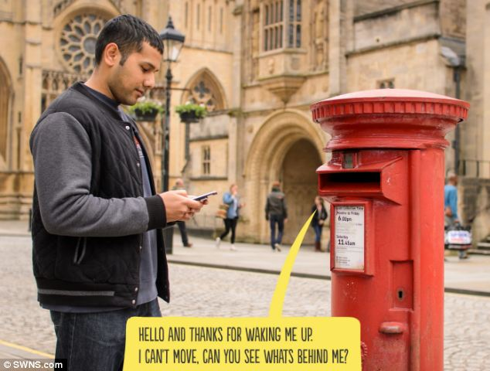
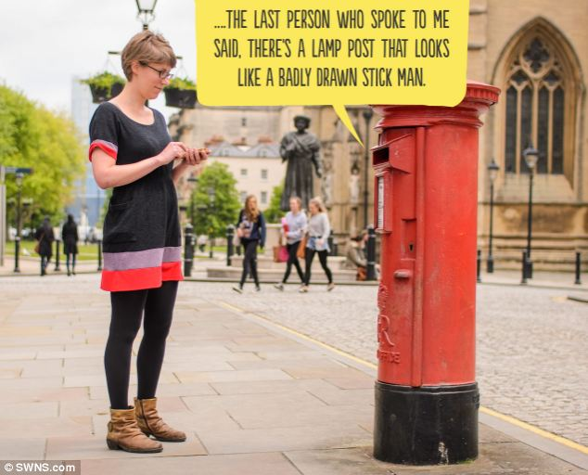
Wax Museum
Start with reading of monologues
Move to writing of monologues
Science, reading, social studies, etc.

Slide 4
Book characters

Slide 5
Science terms: light

Slide 6
Fifth grade wax musuem

